Slide 1
目標

Slide 2
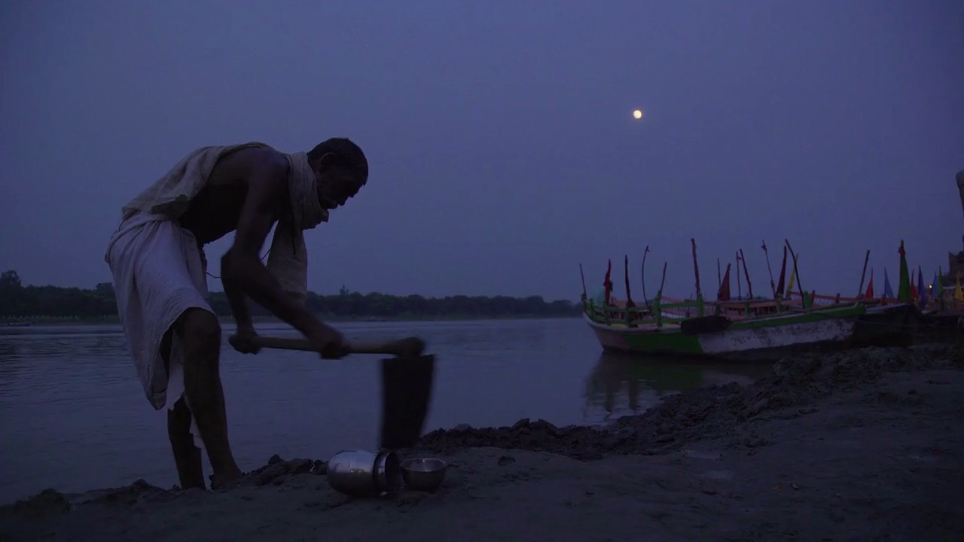
目標
Notes:
https://pixabay.com/videos/worker-early-morning-people-person-1635/

Slide 3
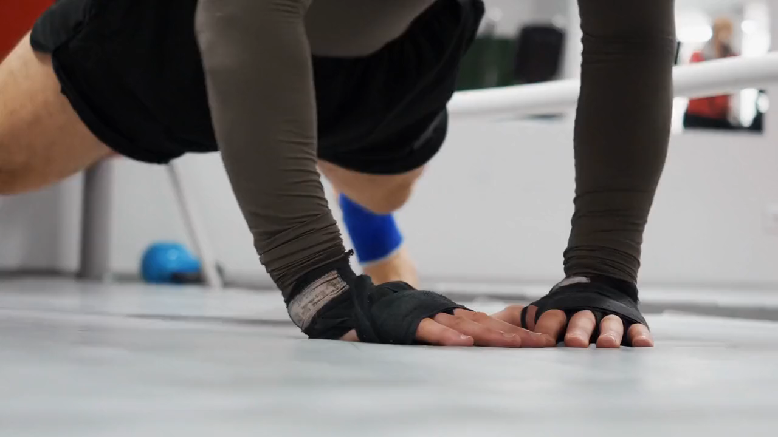
目標
Notes:
https://pixabay.com/videos/pushups-fitness-exercise-work-out-143431/

Slide 4

目標
Notes:
https://pixabay.com/videos/work-office-people-write-87592/

Slide 5
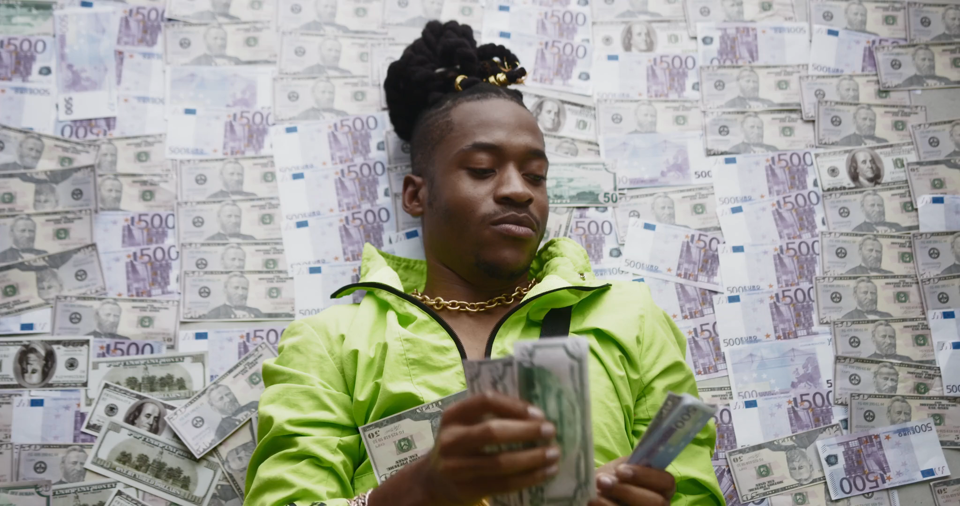
阻礙
Notes:
https://pixabay.com/videos/rich-money-dollar-rich-man-144452/

Slide 6
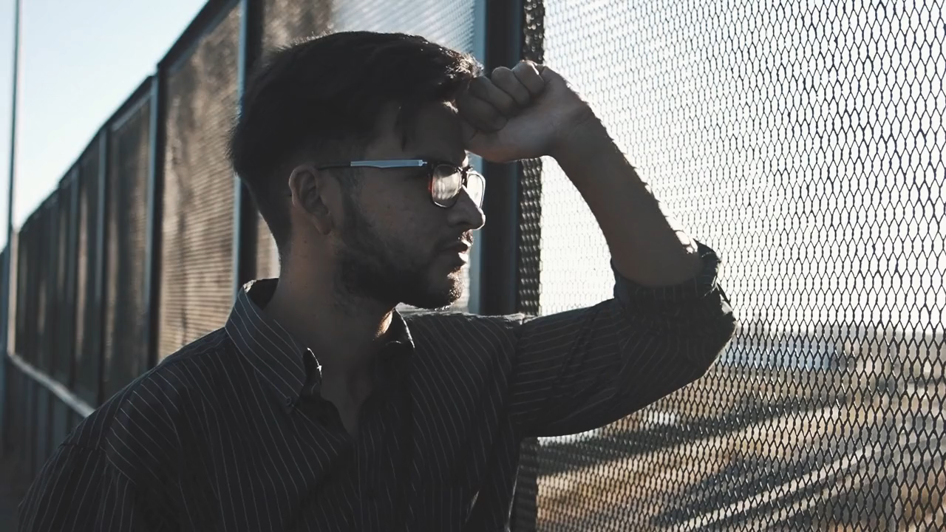
努力
Notes:
https://pixabay.com/videos/man-person-reflection-thinking-126558/

Slide 7

結果
Notes:
https://pixabay.com/videos/sleep-messy-bed-night-wake-pillow-42966/

Slide 8
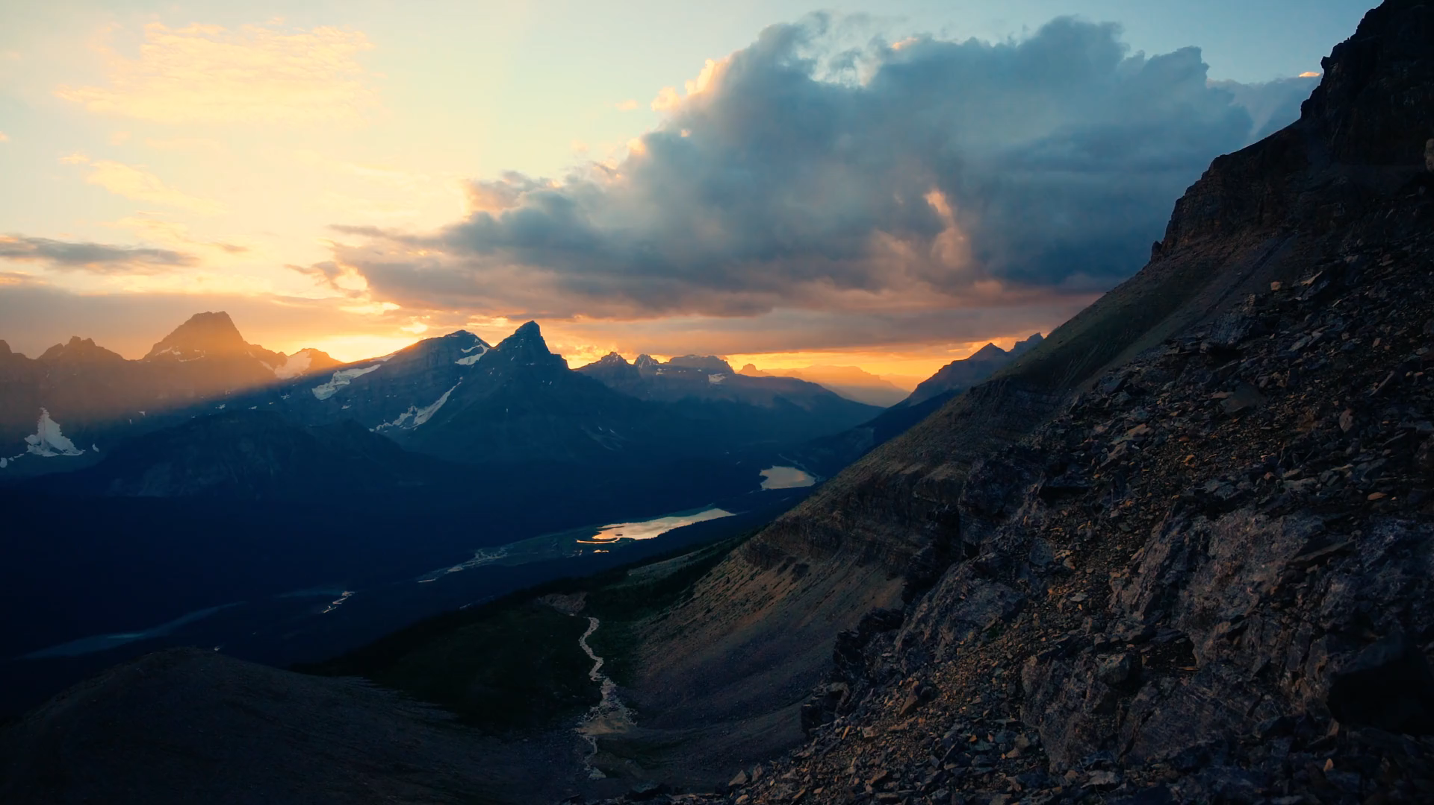
結果
Notes:
https://pixabay.com/videos/mountains-sunset-view-panorama-203681/

Slide 9

意外
Notes:
https://pixabay.com/videos/day-night-dark-time-lapse-22555/

Slide 10
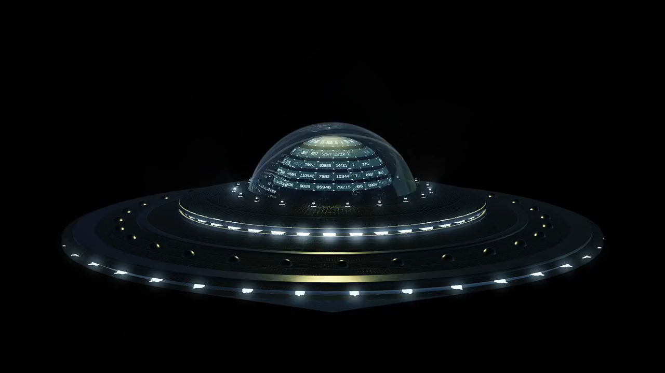
轉彎
Notes:
https://pixabay.com/videos/ufo-extraterrestrial-space-200067/

Slide 11
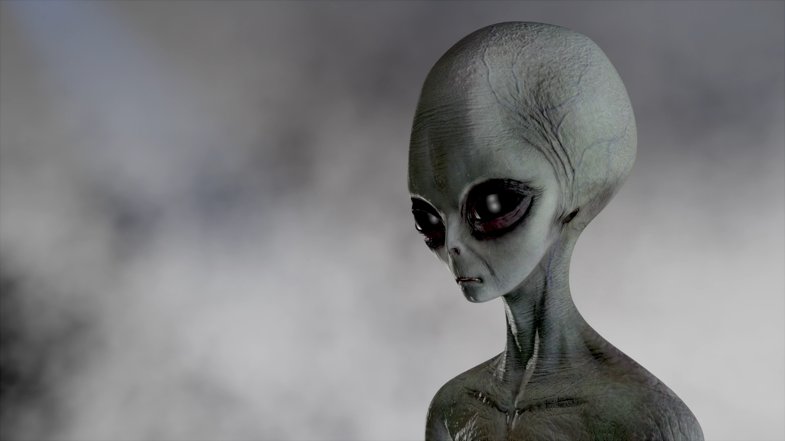
轉彎
Notes:
https://pixabay.com/videos/aliens-extraterrestrial-life-138116/

Slide 12
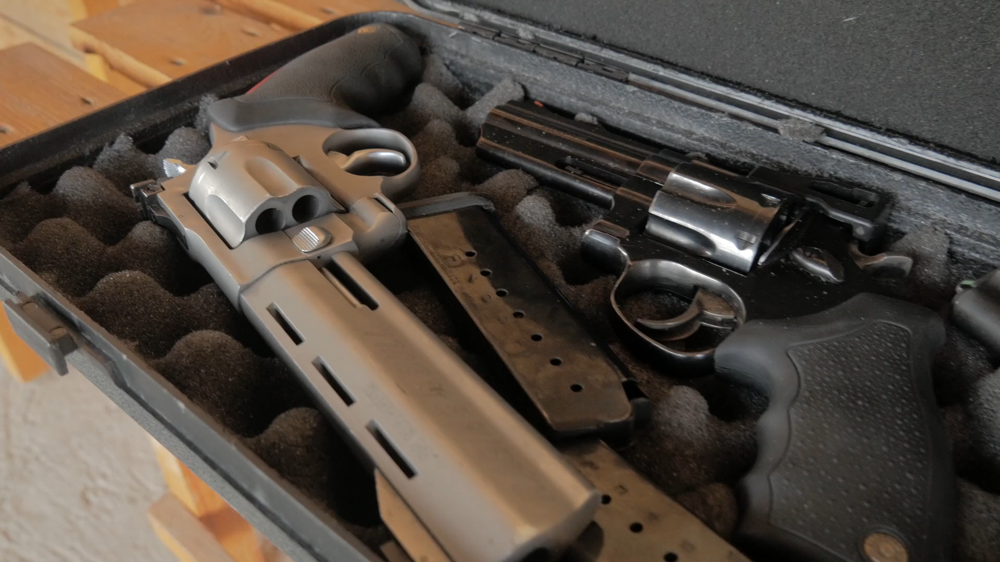
轉彎
Notes:
https://pixabay.com/videos/gun-weapons-pistol-army-military-131127/

Slide 13
結局

